Slide 1
Artificial Intelligence 101
Yongzhe Hong, MD, PhD

Slide 2
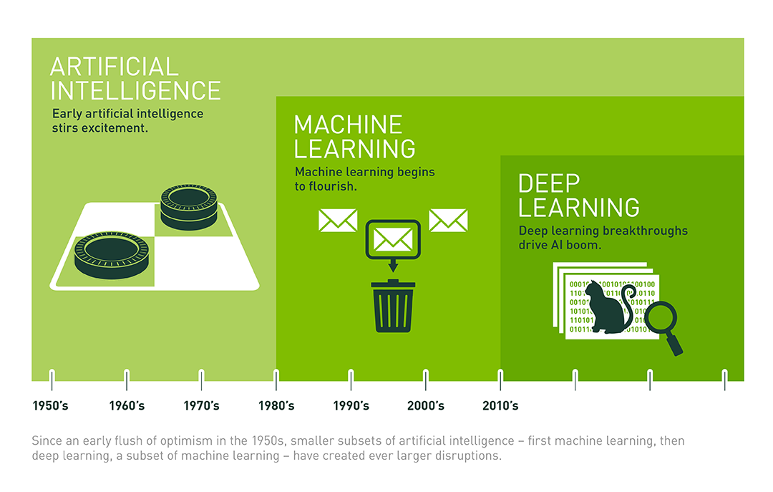
What is AI?
techniques that help machines and computers mimic human behavior
https://www.datasciencecentral.com/profiles/blogs/artificial-intelligence-vs-machine-learning-vs-deep-learning
Notes:
Brief history of AI https://www.youtube.com/watch?v=056v4OxKwlI

Slide 3
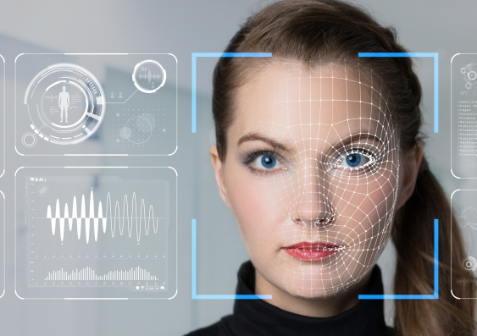


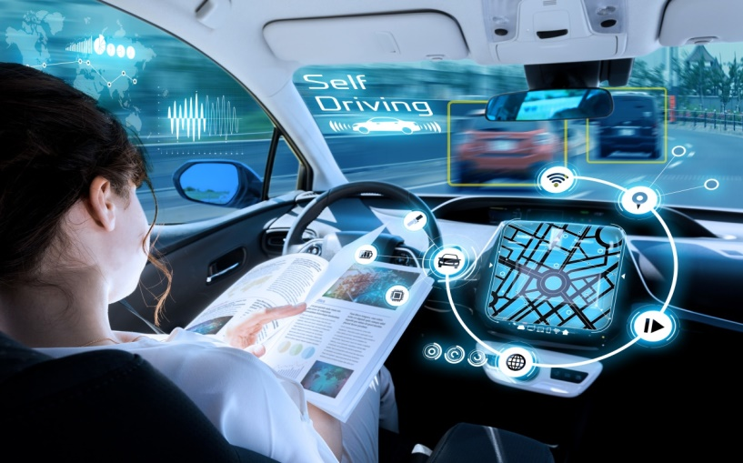
AI application
Face recognition
Machine translation
Speech recognition
Autonomous driving

Slide 4
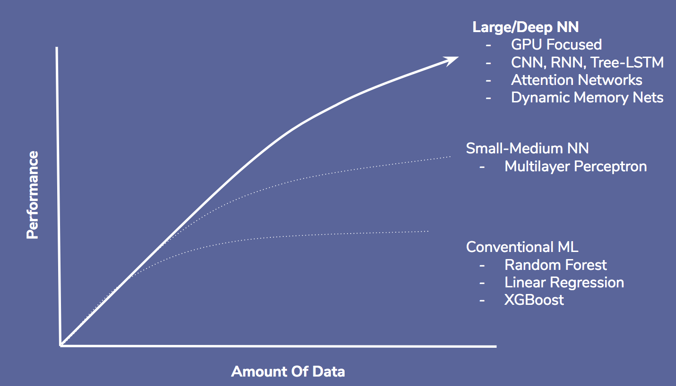
Why now？
https://towardsdatascience.com/deep-misconceptions-about-deep-learning-f26c41faceec

Slide 5
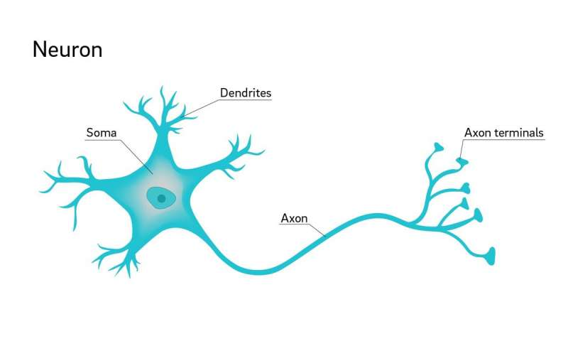
Biological neuron

Slide 6
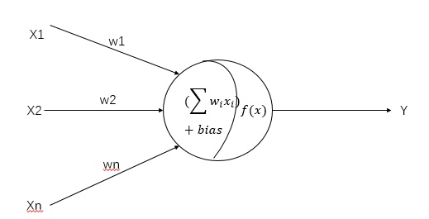
Single neuron in neural network
f(x)=w₁X₁+ w₂X₂+…+wnXn+ b

Slide 7
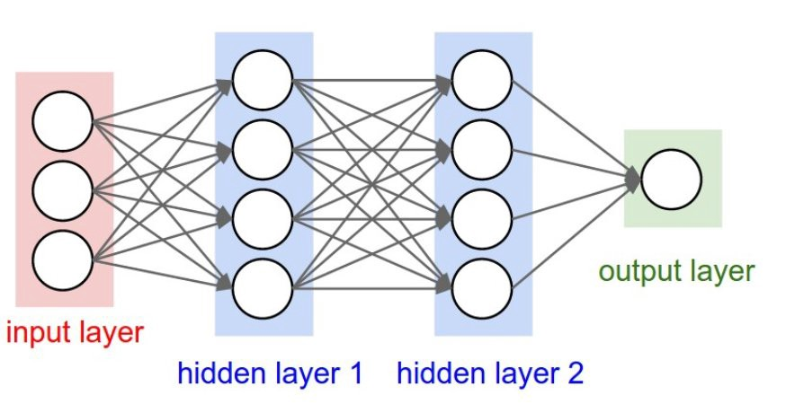
Typical neural network architecture

Slide 8
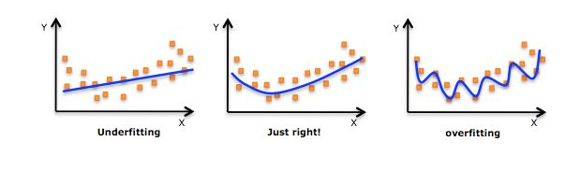
Overfitting in ML

Slide 9
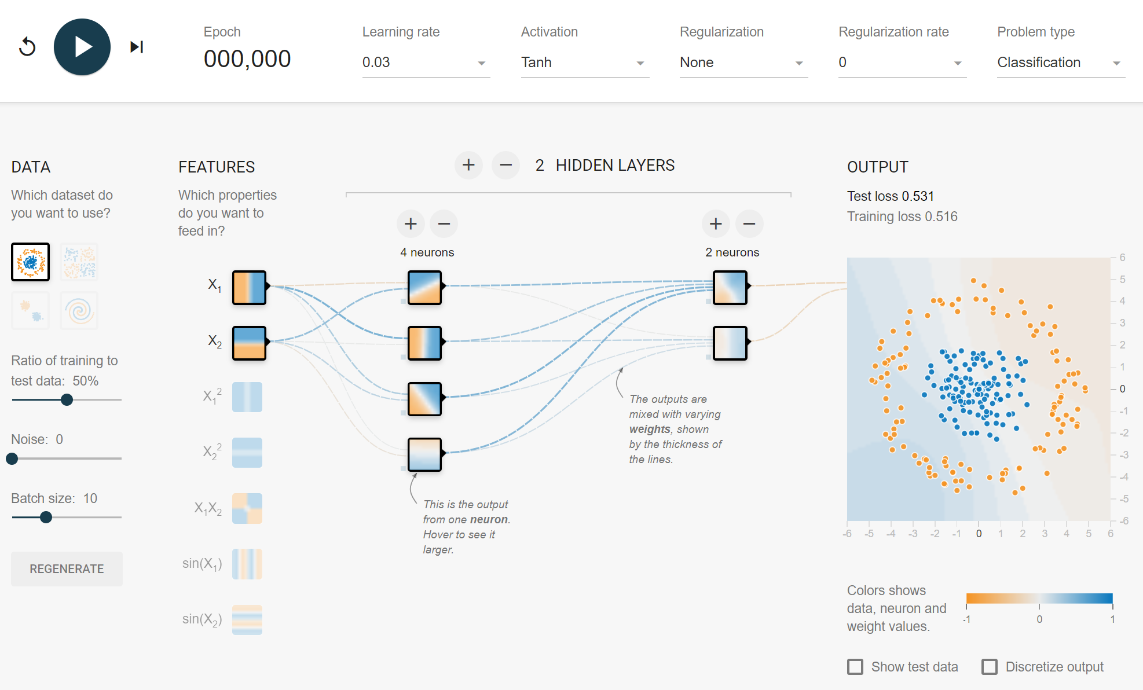
Deep neural network
Notes:
https://playground.tensorflow.org/#activation=tanh&batchSize=10&dataset=circle&regDataset=reg-plane&learningRate=0.03&regularizationRate=0&noise=0&networkShape=4,2&seed=0.83752&showTestData=false&discretize=false&percTrainData=50&x=true&y=true&xTimesY=false&xSquared=false&ySquared=false&cosX=false&sinX=false&cosY=false&sinY=false&collectStats=false&problem=classification&initZero=false&hideText=false

Slide 10
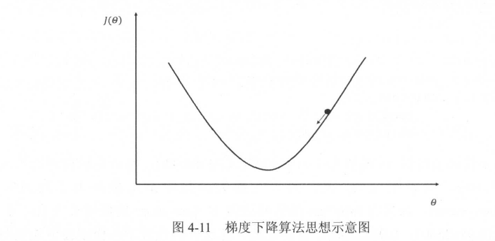
Optimization Process

Slide 11
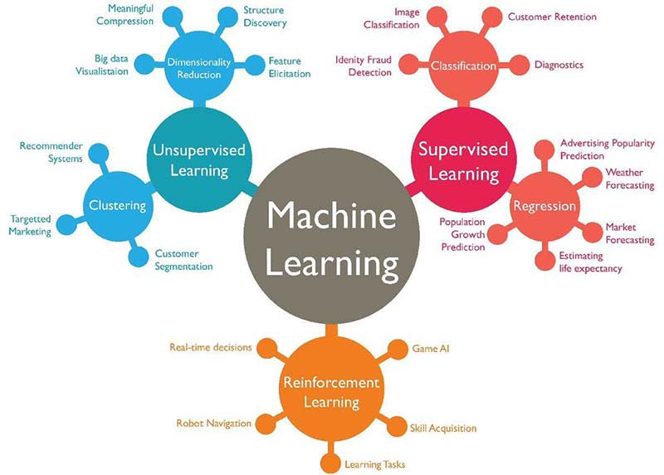
https://medium.com/marketing-and-entrepreneurship/10-companies-using-machine-learning-in-cool-ways-887c25f913c3

Slide 12
Supervised learning
Develop predictive model using both input and output data
Linear regression
Decision tree
Random forest
Neural network…
K-Nearest Neighbors (KNN)
Support Vector Machine, SVM
Logistic regression
Naïve Bayes
Neural network…

Slide 13
Unsupervised learning
Group and interpret data based only on input data
Principal component analysis(PCA)
Singular value decomposition (SVD)
K-means
Association analysis
Hidden Markov model

Slide 14
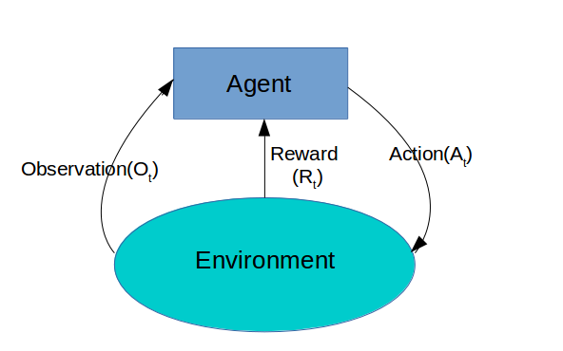
Reinforcement learning

Slide 15
When should we use ML?
Handling unstructured data, including image, text, audio, video
Complex data
Lots of variables
No existing formula or equation
Limited prior knowledge

Slide 16
Limitations of ML
Difficult to interpret
Require large amount of data
Computation limitations
ML algorithms does not understand context

Slide 17
Summary
The major progress of AI in recent years is the outstanding performance of neural network and reinforcement learning with big data and enormous computing power.
Machine learning can analyze unstructured data, such as image, text, audio and video.
General AI is still a long way to go. Current AI can only handle specific task.
Machine learning is good at prediction, as it only cares about association not causation.

Slide 18
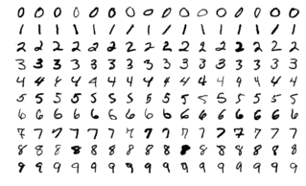
A taste of AI with MNIST
The MNIST database is a large database of handwritten digits that is commonly used for training various image processing systems. The database is also widely used for training and testing in the field of machine learning. It was created by "re-mixing" the samples from NIST's original datasets.
The MNIST database contains 60,000 training images and 10,000 testing images.

Slide 19
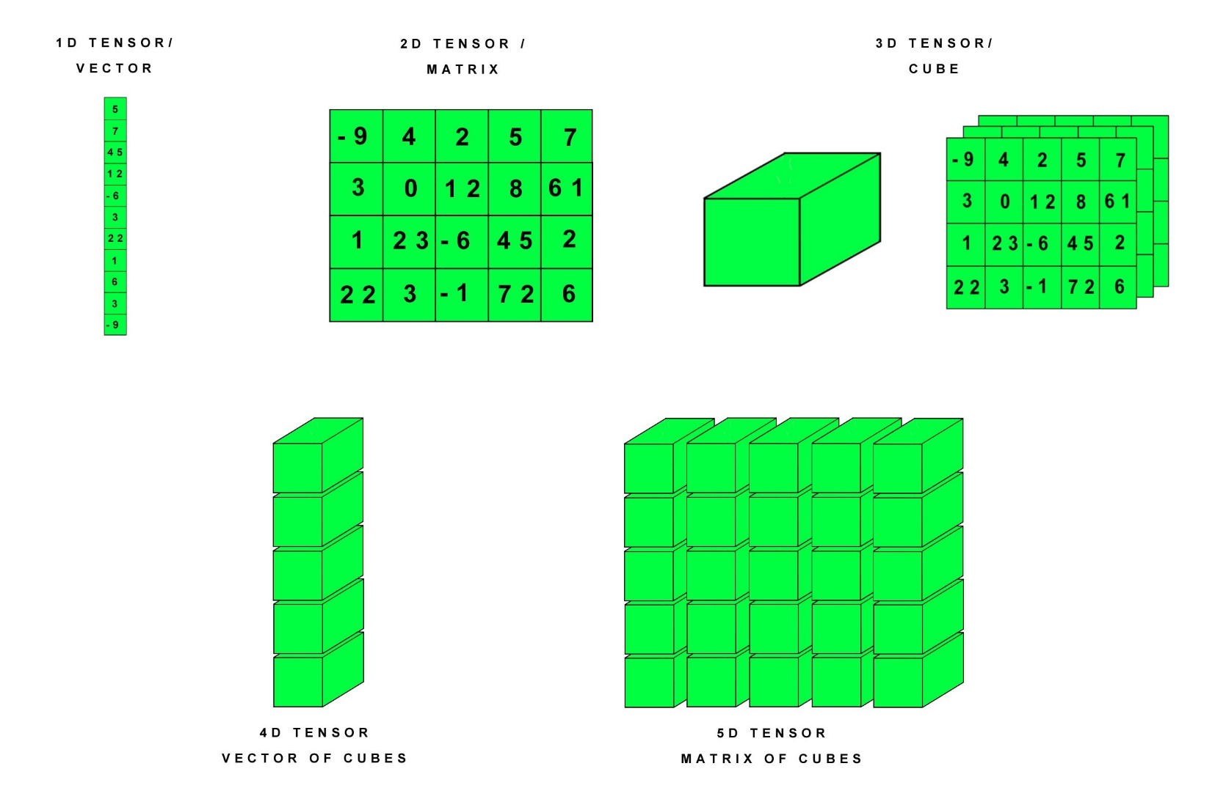
Tensor

Slide 20
Image sources
Autonomous driving: https://www.smartcitiesworld.net/smart-cities-news/smart-cities-news/pittsburgh-sets-out-new-rules-for-self-driving-cars-3920
Speech recognition: https://www.businessnewsdaily.com/10995-speech-recognition-software-business.html
Face recognition: https://newsroom.unsw.edu.au/news/science-tech/human-plus-machine-%E2%80%93-face-recognition-its-best
Machine translation: https://www.transperfect.com/blog/machine-translation-solution-you-can-bank-on
Neuron: https://www.google.com/url?sa=i&source=images&cd=&cad=rja&uact=8&ved=2ahUKEwjtmbmx8LzhAhUOZd8KHYH1C-0QjRx6BAgBEAU&url=https%3A%2F%2Fmedicalxpress.com%2Fnews%2F2018-07-neuron-axons-spindly-theyre-optimizing.html&psig=AOvVaw0qX1Xb9uTAaW9uP3EY53m1&ust=1554688559817549
Neural network architecture: https://www.google.com/url?sa=i&source=images&cd=&cad=rja&uact=8&ved=2ahUKEwjy1tPs-LzhAhUriOAKHYI4BzAQjRx6BAgBEAU&url=https%3A%2F%2Fhackernoon.com%2Fchallenges-in-deep-learning-57bbf6e73bb&psig=AOvVaw0PO8i7JQmYZXGu86nhtvLs&ust=1554690837533228

